Slide 1
What I Have Learned from Children
Shiori Yamamoto (Japan)

Slide 2
Introduction
This presentation is created to show you some tips for giving presenations to young audiences. All the tips were based on my own experience from working at an after school program for Pre-K through 5th grade students.

Slide 3
Executive Function
Before getting started…some facts about child development that might be helpful.
Have you heard of the word “Executive function”? Executive function is responsible for allocating attention, planning and multitasking.

Slide 4
Developmentally speaking...
Prefrontal cortex (the yellow part in the picture below) regulates executive function and develops from birth until young adulthood (about 25 years old). There fore, It is NORMAL for children to get distracted!

Slide 5
How Can We Grab Children’s Attention?

Slide 6
Explain the detail of what you are going to do at the beginning of the presentation
For example, “ Today, I will be talking about two major Japanese holidays, New Year and Obon in the presentation. I have Q & A time at the end, so please save your questions. After the presentation, I have an origami activity for you. We will be making rose flower with origami paper.”

Slide 7
From my experience, even though children follow the same routine everday, teachers still need to remind them of what to do bext EVERY TIME they move onto the next activity. When we go to schools, we are guests and break their routine. This is why it is very important to let them know what to expect in order to keep their attention.

Slide 8
Use Pictures
and Technology when possible!

Slide 9
This applies especially to younger audiences (Pre-K though 2nd or 3rd grade students). Some younger audiences are still learning how to read. Using pictures is really helpful for them to understand the presentations. In addition, if there is any available relevant technology resources, I highly recommend using them. They are helpful for both auditory and visual learners and easier to grab children’s attention.

Slide 10
Make students
participate !
BUT!!

Slide 11
Hold answering questions
until the END of your presentation

Slide 12
I encourage you to answer all the questions at the end, if possible. Sometimes, children have questions that are irrelevant to the presentation. If you answer one question, you will need to answer other questions from other students. It is very difficult to go back to the presentation once they get sidetracked.

Slide 13
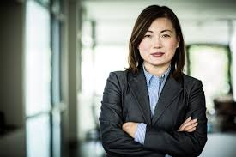
Take control in the classroom!

Slide 14
What exactly does that mean?
It is very important and effective to show children assertiveness when things get out of control. Although it might be awkward to show dominance in the presence of the classroom teacher, you need to take control in the classroom while giving the presentation. You spend time on preparing for the presentation, so children need to learn to be respectful for your time and effort.

Slide 15
Other tips
Communicate with the teachers to check what kind of attention grabbing techniques they usually use
Clapping hands with rhythm
(Teachers) 1, 2, 3, eyes on me!
(Children)1, 2, 3, eyes on you!
Songs

Slide 16
When you do not know the answer….

Slide 17
It is okay to tell them that you don’t the answer. Children should know that adults don’t know everything.
When children ask you questions that you can’t answer at the moment, I would thank them for asking the questions first. And tell them I would get back to them with the answer after the presentation.

Slide 18
Tips for choosing Activities

Slide 19
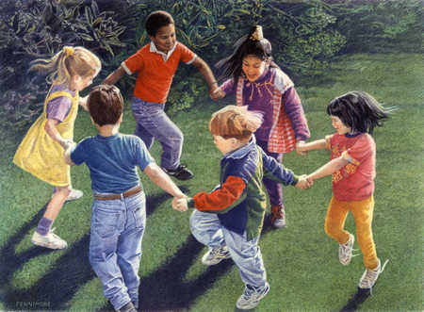
For Younger Audience : Pre-K - 2nd grade
From my experience, it might be a little bit difficult for younger children to do detail-oriented activities that require to use their hands such as writing letters and making crafts. I recommend activities that have children stand up and move their bodies, for example, dancing and singing.

Slide 20
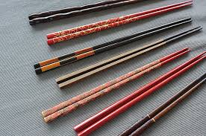
School Aged Audience: 3rd grade and older
Older students are capable of doing more complicated activities. I usually lead activities such as origami, chopsticks and name writing when I visit to a classroom that is older than 3rd grade. It is always best to communicate with the teachers to check what the students like to do before creating activities.

Slide 21
Every classroom is different and Be yourself
I hope all the tips on this presentation are helpful.
Remember that every classroom you will go to is different. Please be prepared for unexpected things that might happen during the presentation and don’t forget to be yourself. Even though you think you didn’t do very well on your presentation, I’m sure children will be thankful to you for giving a presentation, because what you do in the ICSP certainly gives them different perspectives and teaches them new knowledge about the world.

